Slide 1
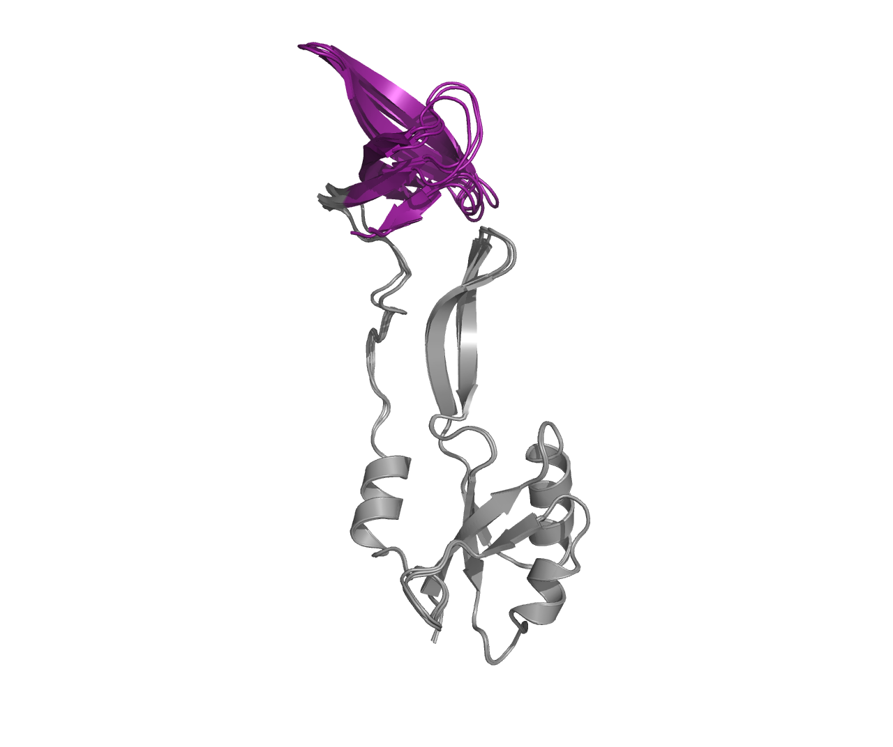
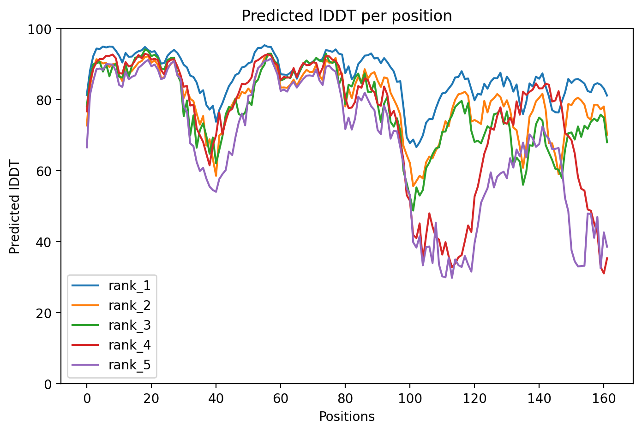
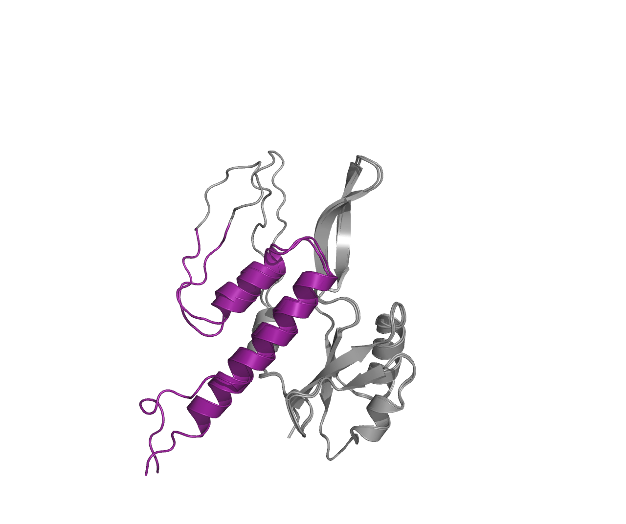
Variant 3
Models 1,2 and 3
Models 4 and 5
Notes:
RfaH

Slide 2
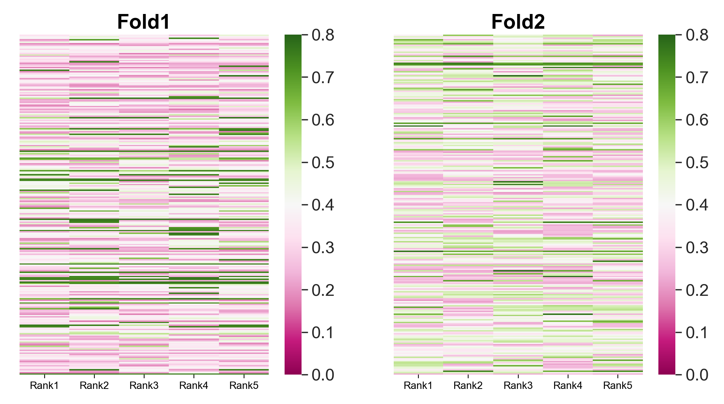
Heatmap of TM-scores, fold-switching region
Notes:
Var3 or RfaH, both folds are observed

Slide 3
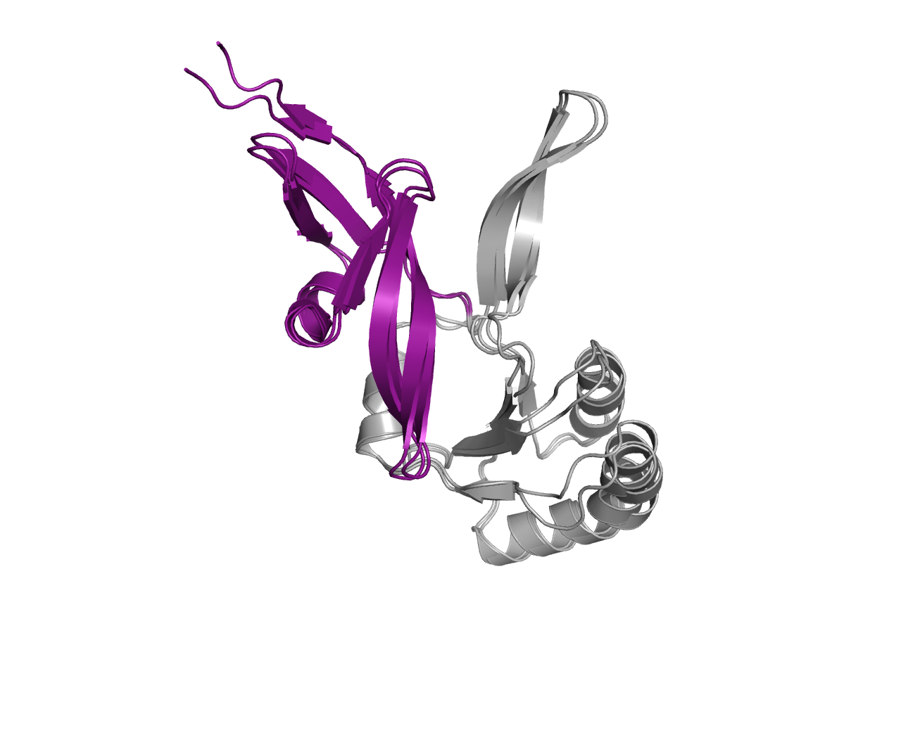
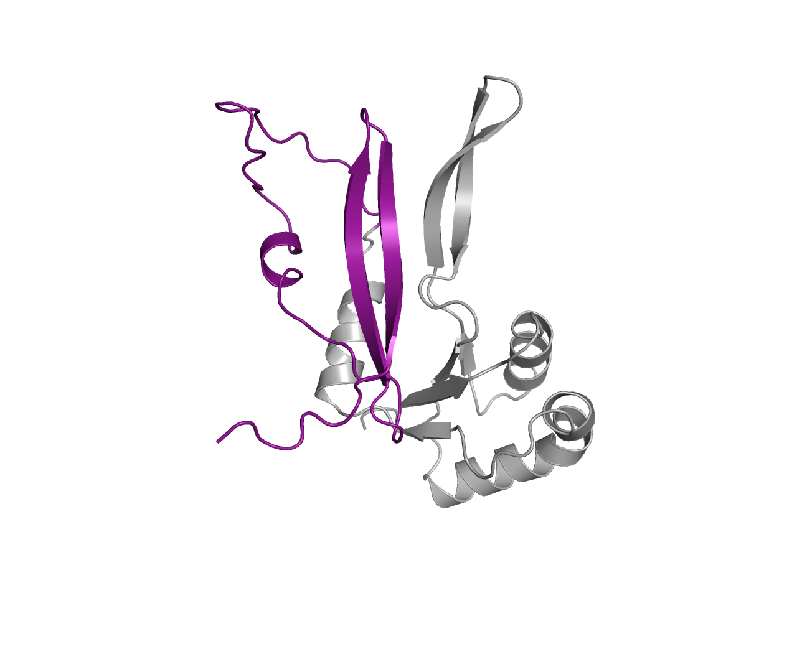
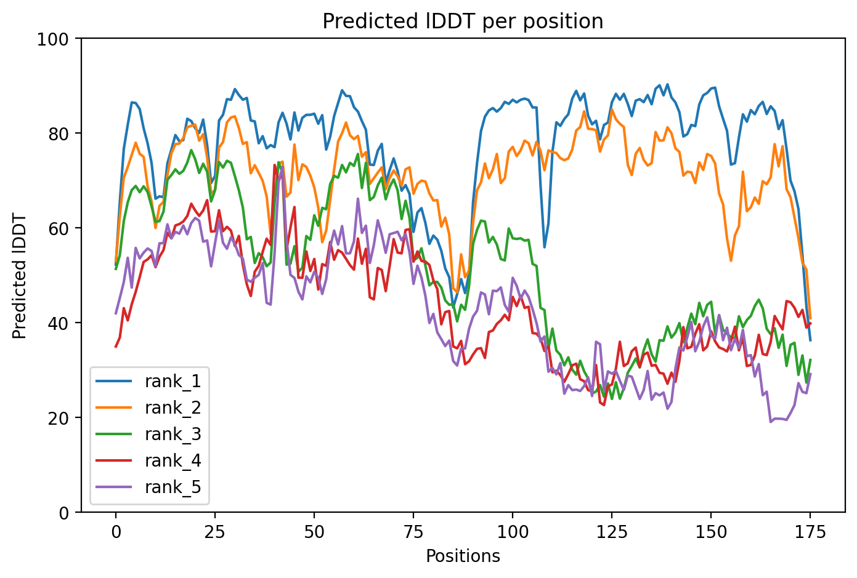
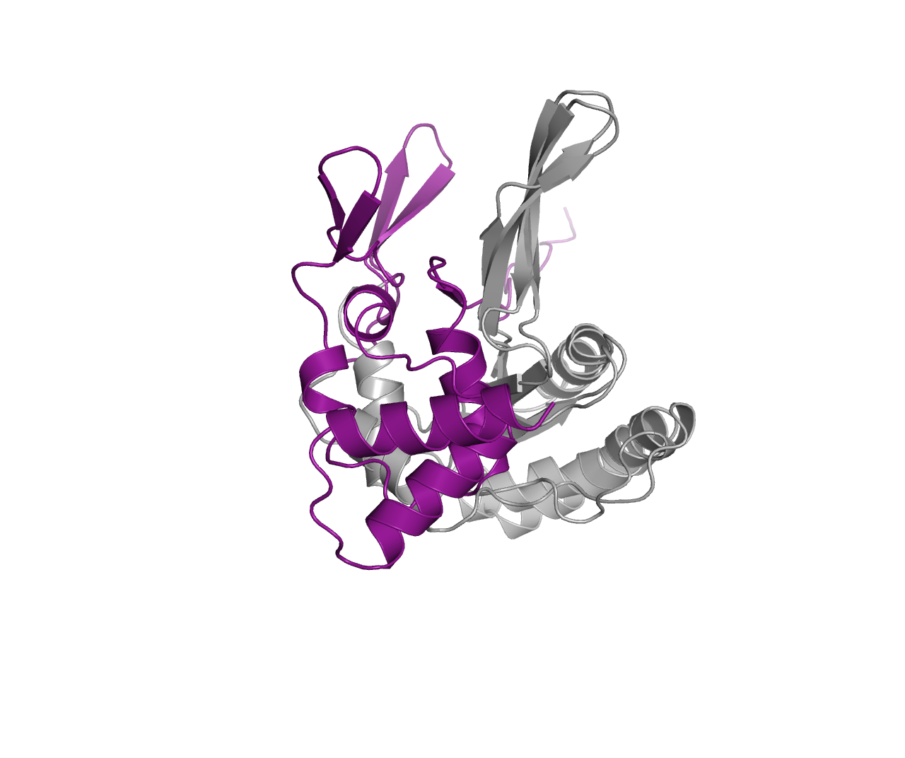
Variant 1
Model 3
Models 1,2
Models 4,5
Notes:
Sort of, some models show helical segment in CTD

Slide 4
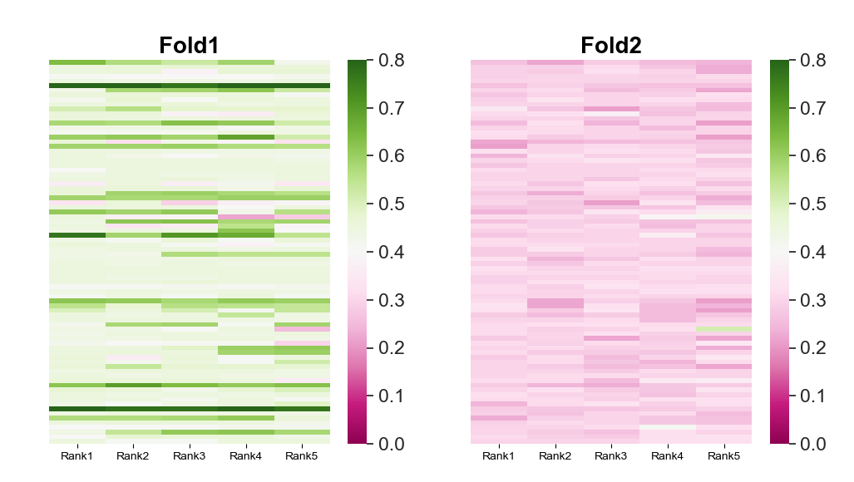
Heatmap of TM-scores, fold-switching region
Notes:
Var1

Slide 5
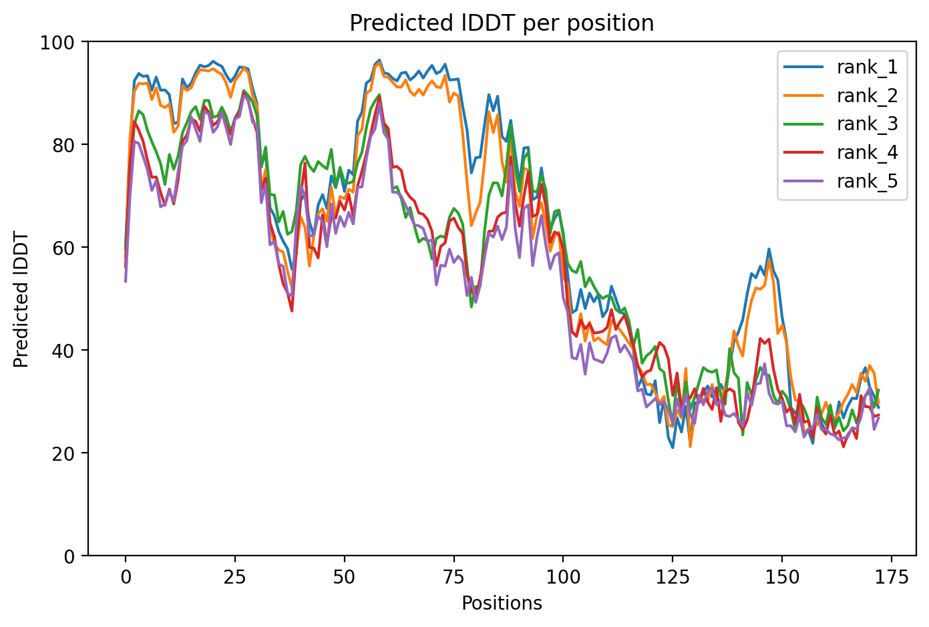
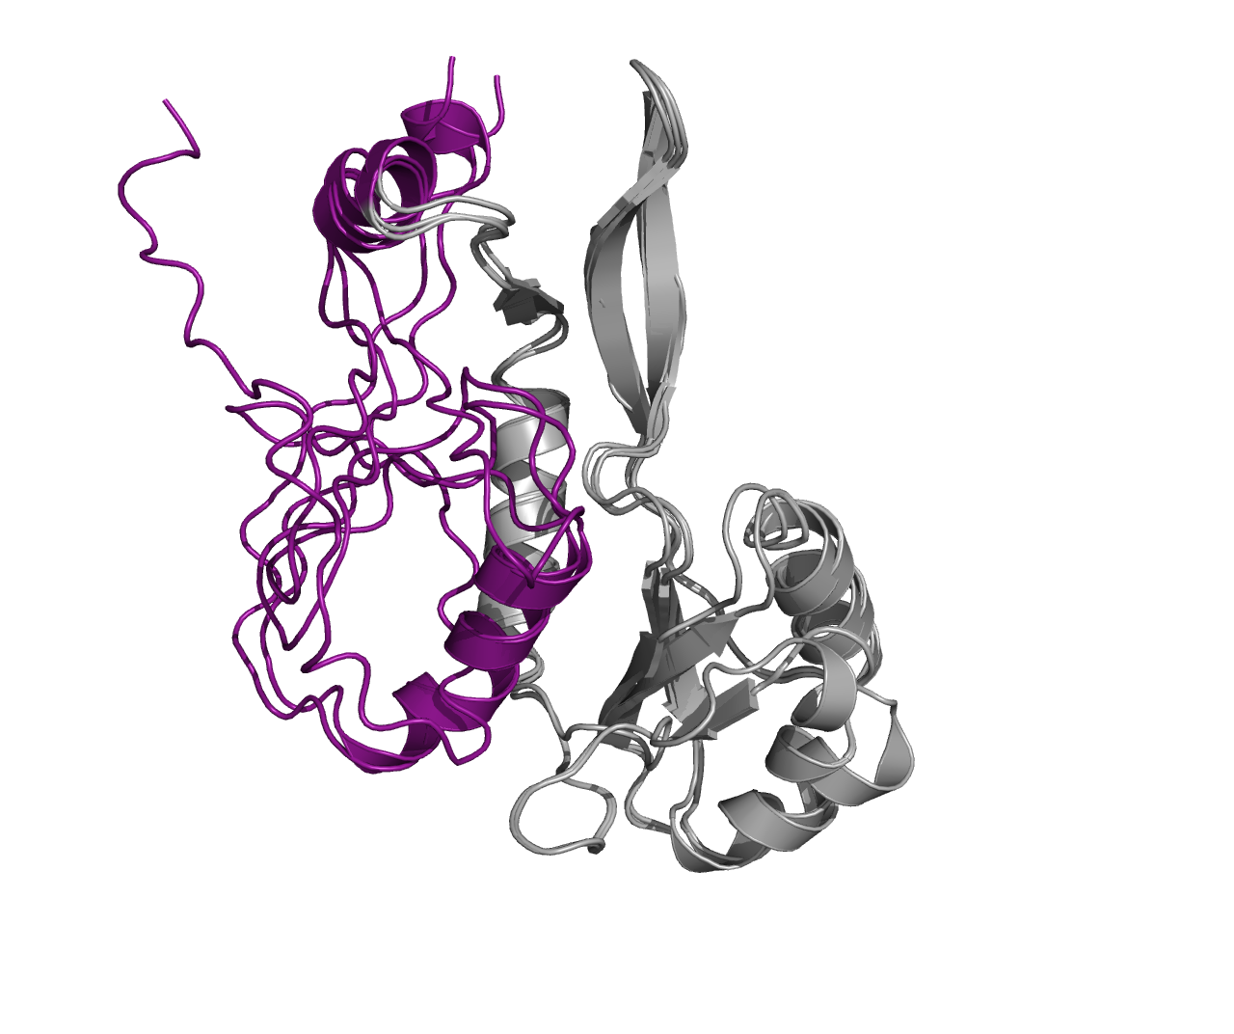
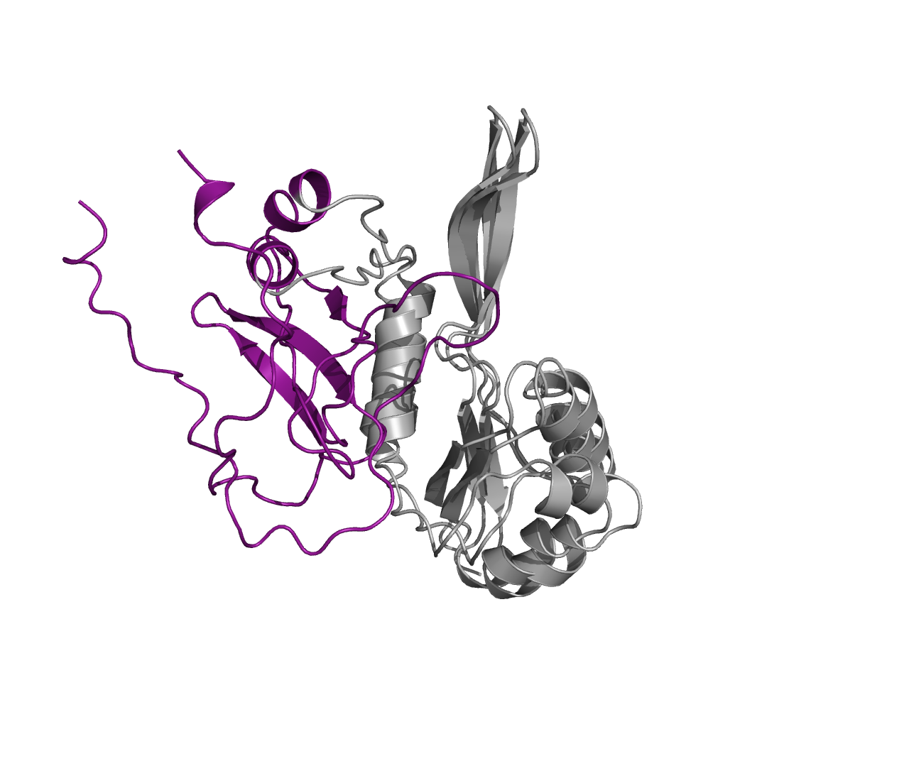
Variant 2
Models 1,2 and 3
Models 4 and 5
Notes:
Sort of, but mostly unstructured in the CTD

Slide 6
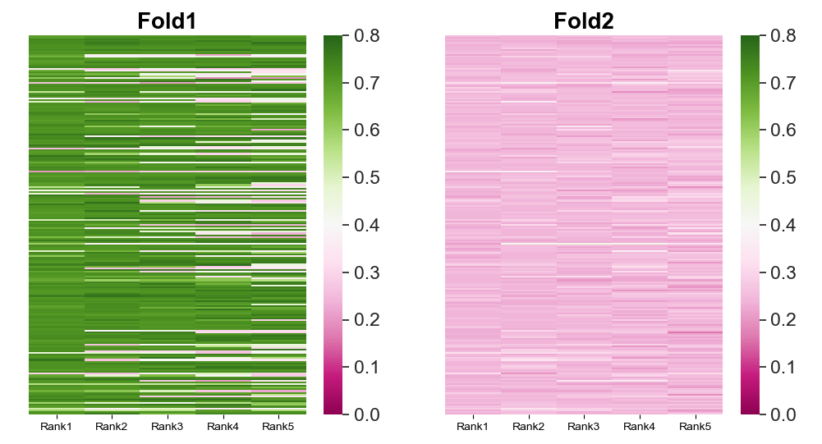
Heatmap of TM-scores, fold-switching region
Notes:
Var2

Slide 7
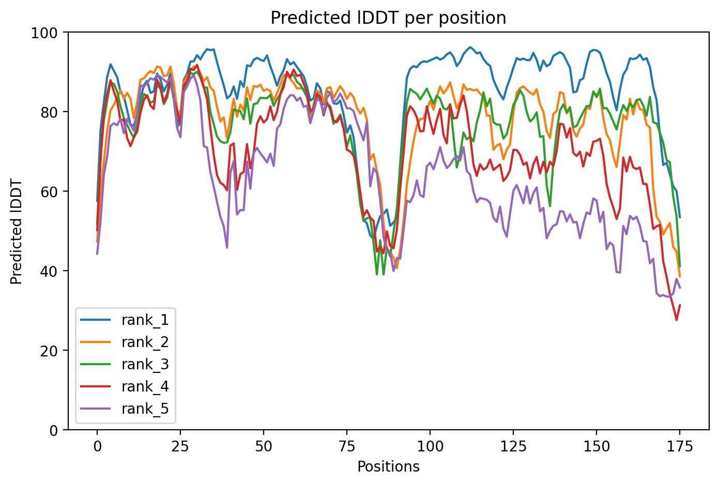
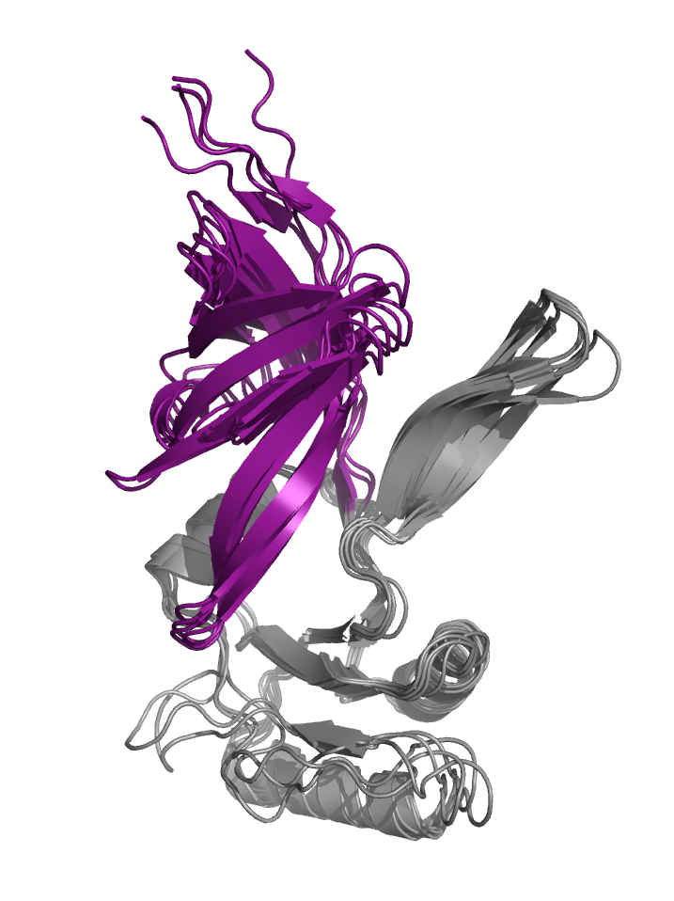
Variant 4
Notes:
No helical segments found in any of the predictions

Slide 8
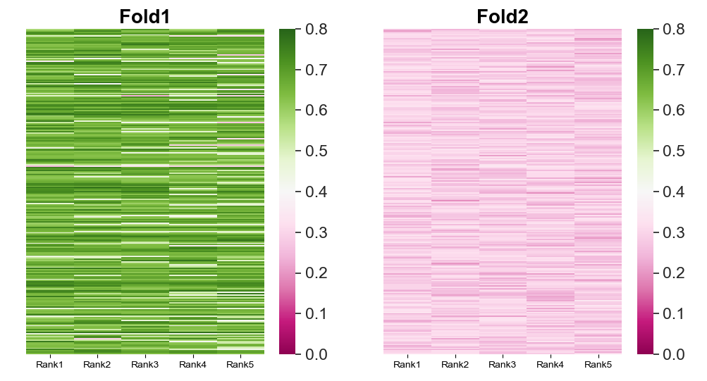
Heatmap of TM-scores, fold-switching region
Notes:
Var4

Slide 9
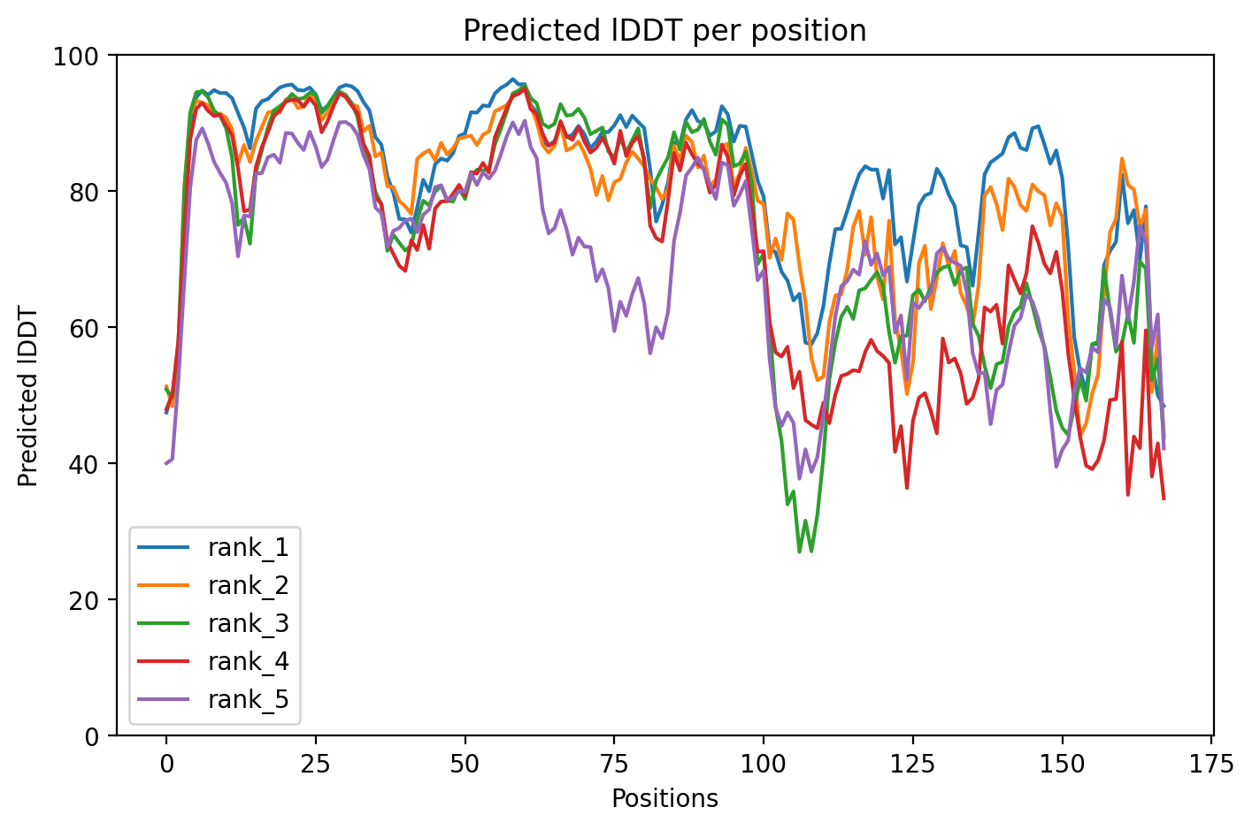
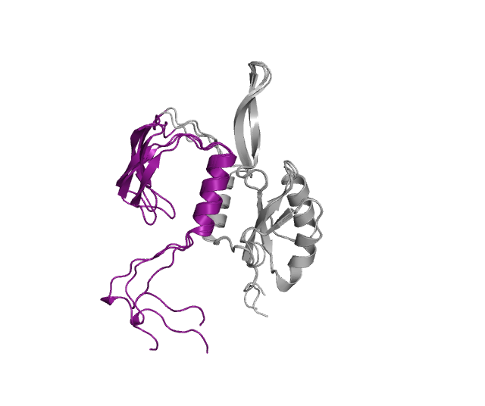
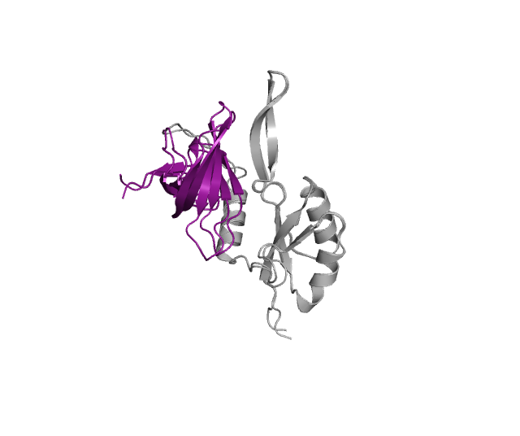
Variant 5
Models 1,2 and 4
Models 3 and 5
Notes:
Sort of, Chimera like

Slide 10
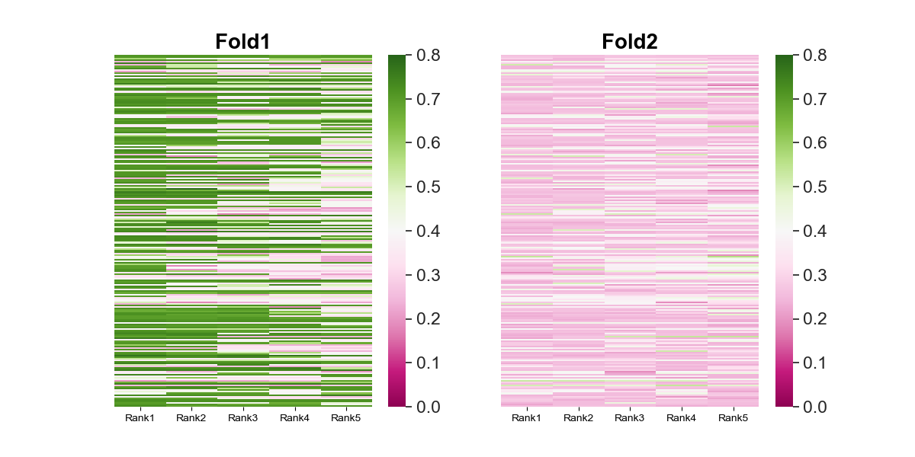
Heatmap of TM-scores, fold-switching region
Notes:
Var5

Slide 11
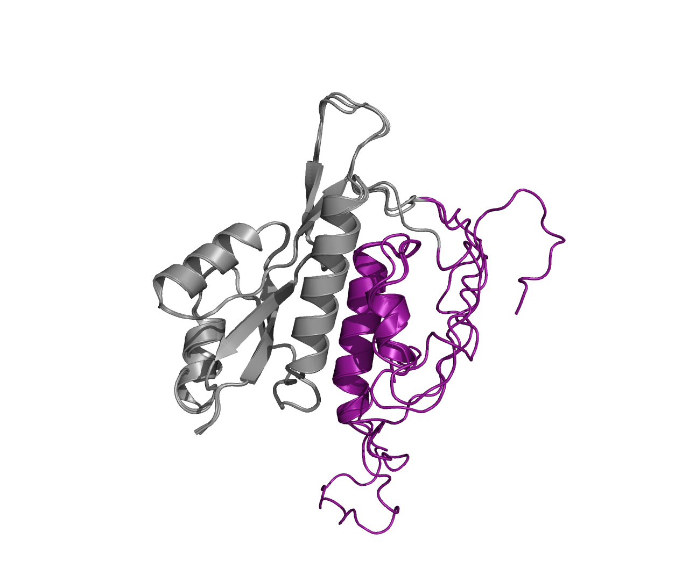
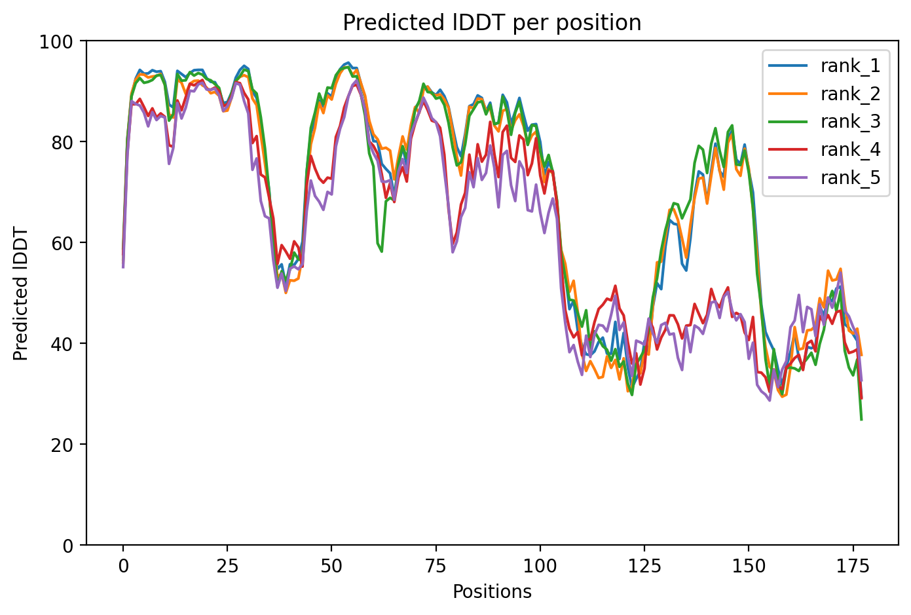
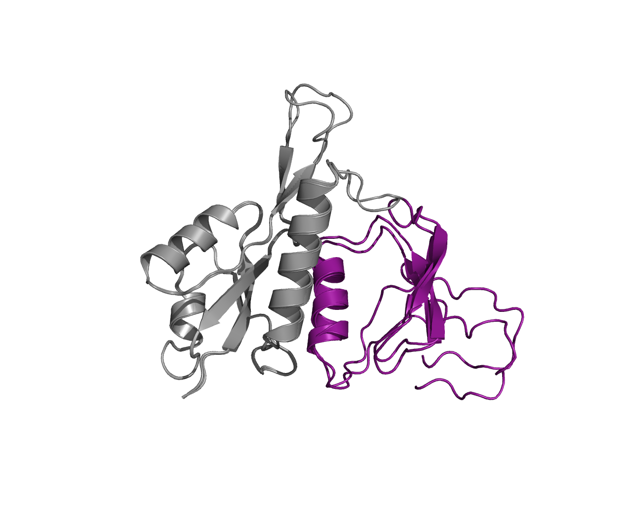
Variant 6
Models 1,2 and 3
Models 4 and 5
Notes:
Sort of, but mostly unstructured segments in CTD

Slide 12
Heatmap of TM-scores, fold-switching region

Slide 13
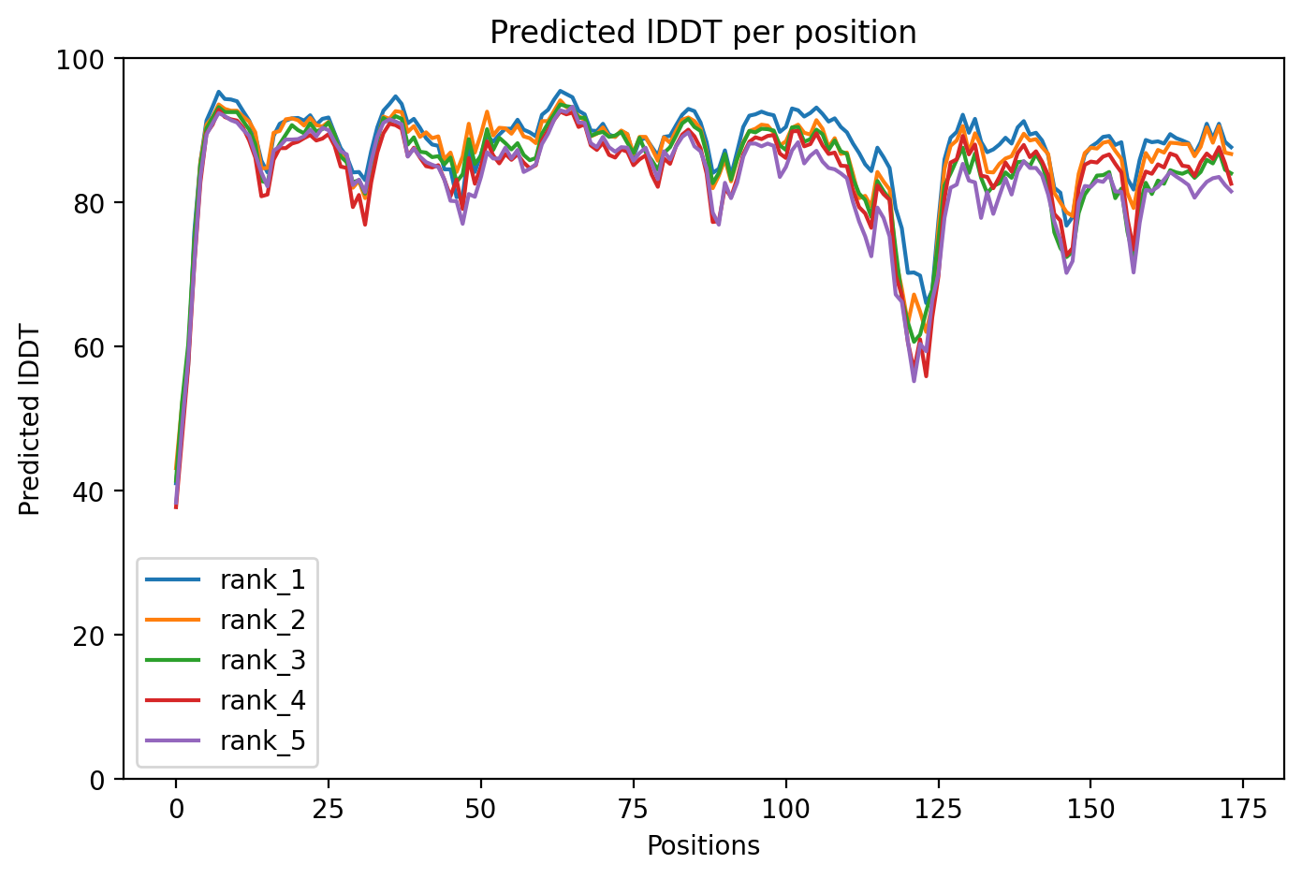
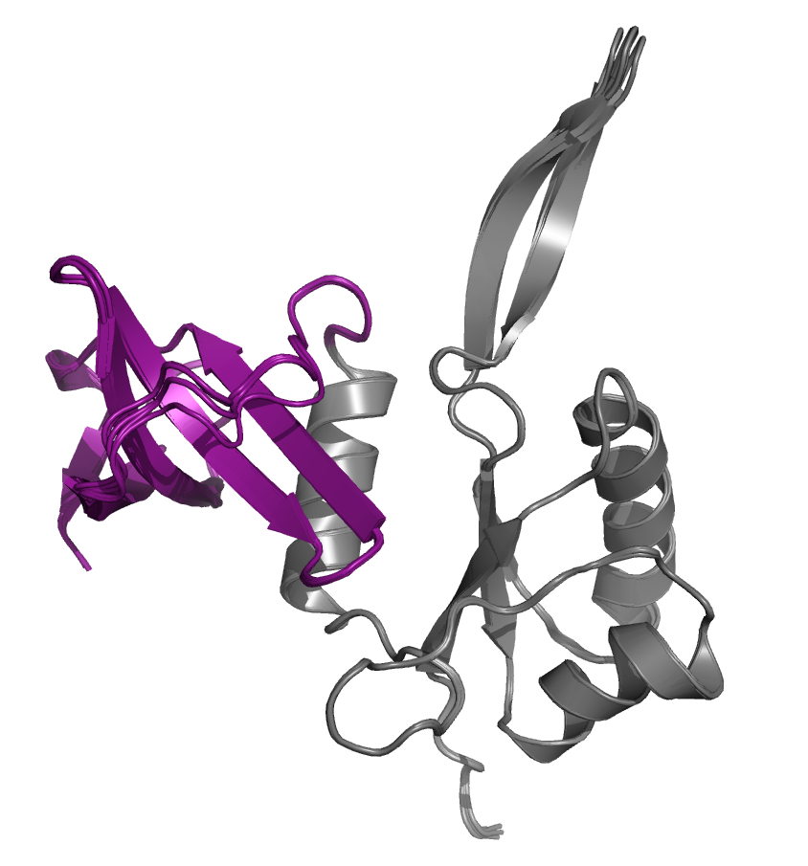
Variant 7
Notes:
No helical segments found in CTD

Slide 14
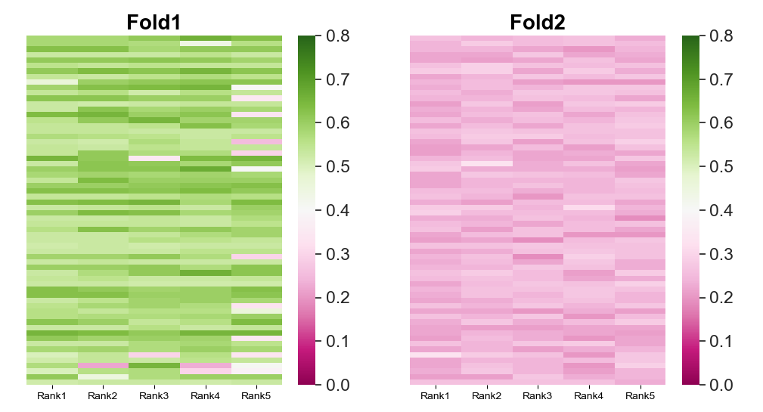
Heatmap of TM-scores, fold-switching region
Notes:
Var7

Slide 15
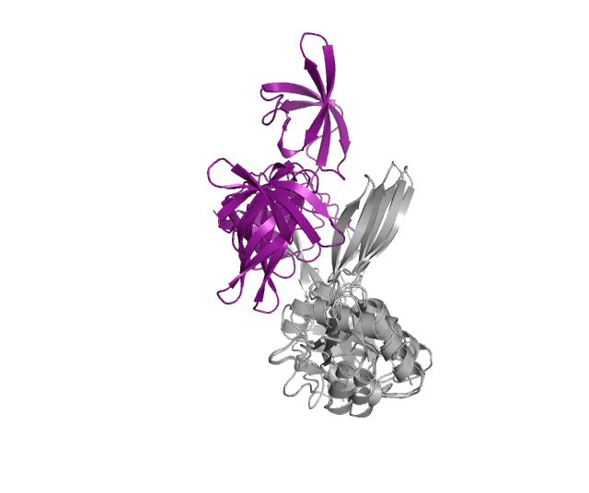
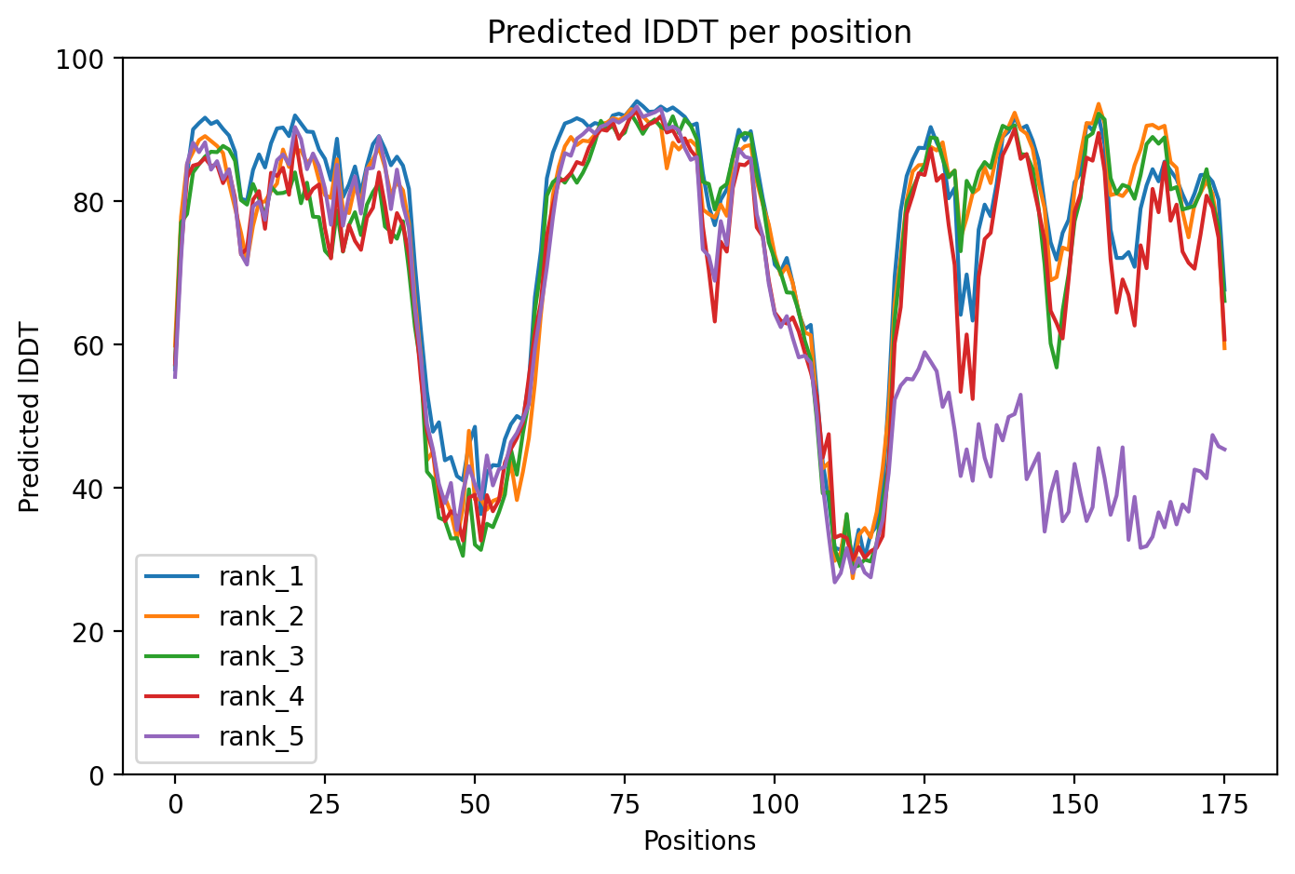
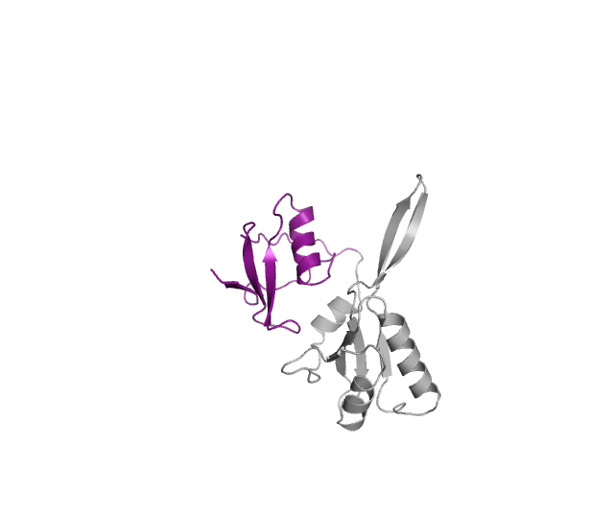
Variant 8
Notes:
Sort of, chimera like with both segments of alpha helix and beta sheet, not biological

Slide 16
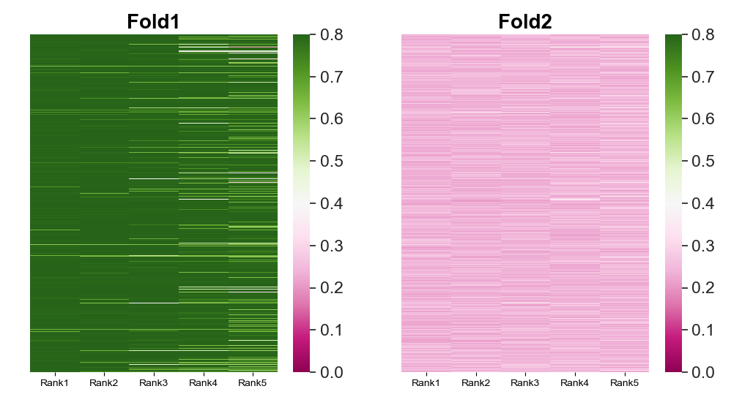
Heatmap of TM-scores, fold-switching region
Notes:
Var8

Slide 17
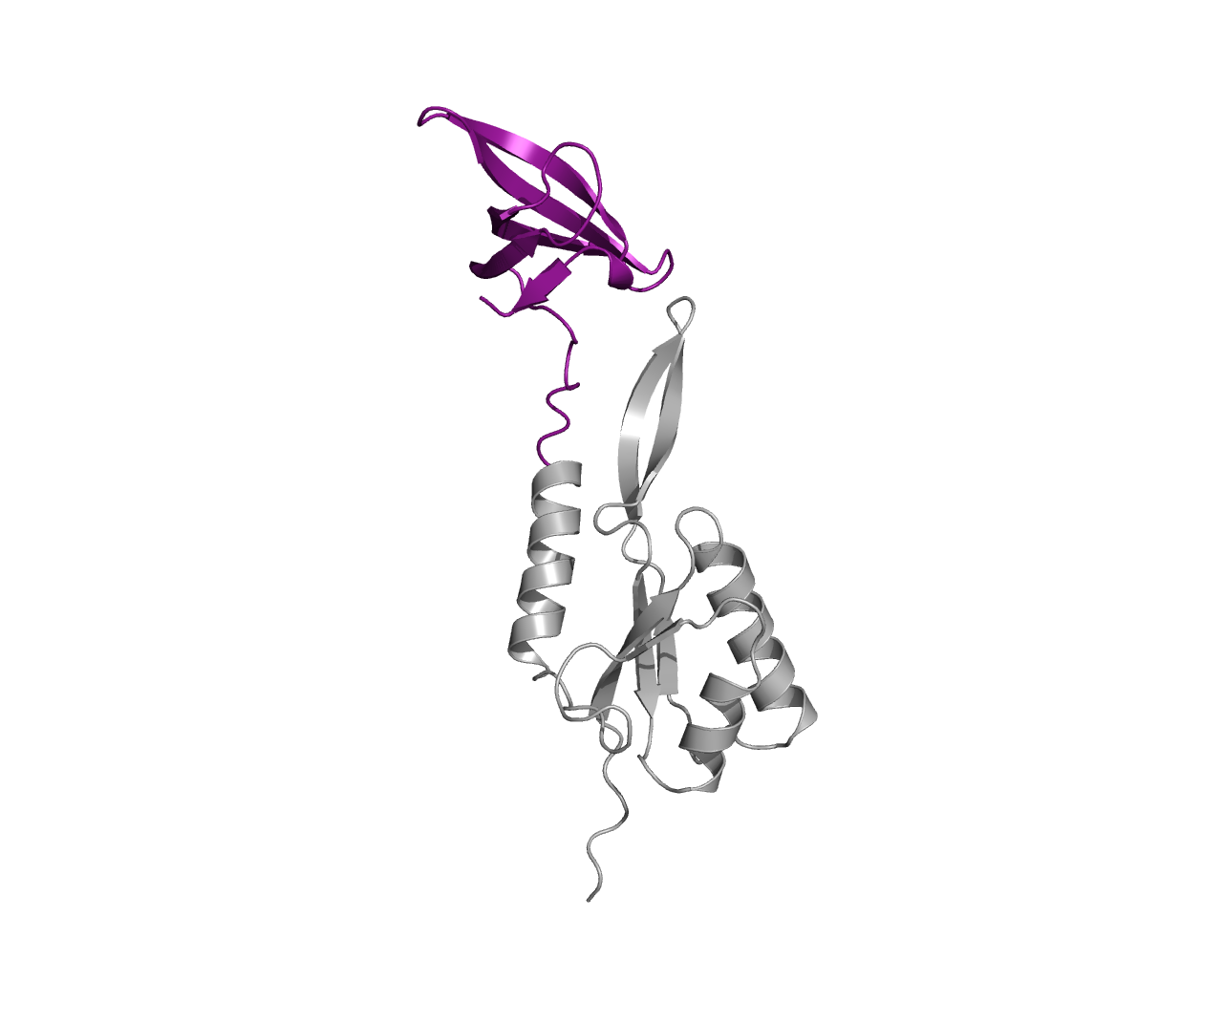
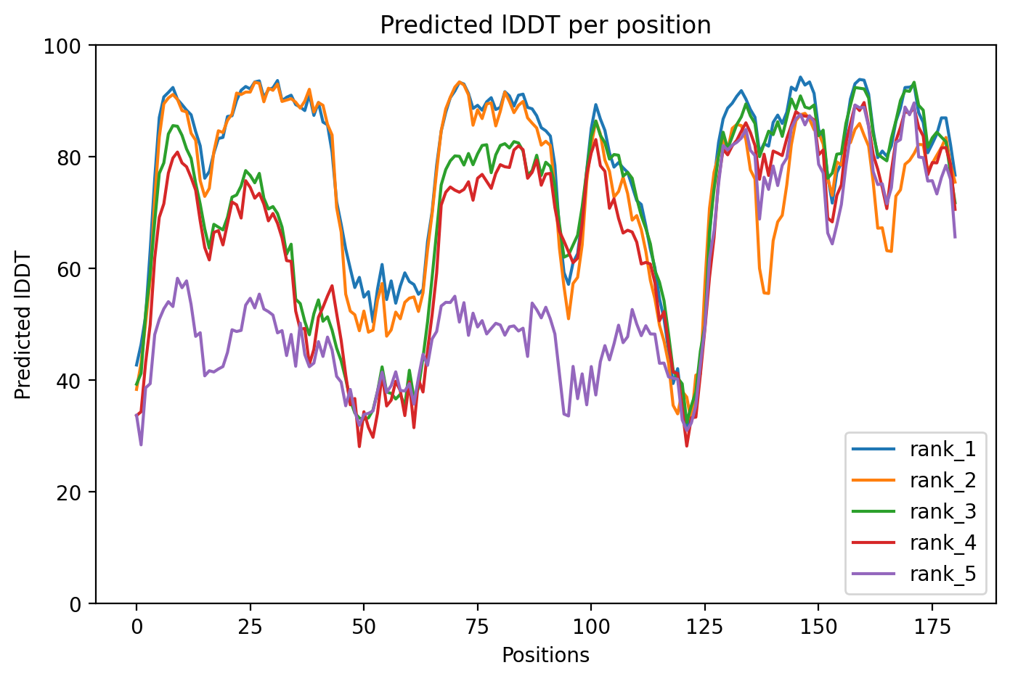
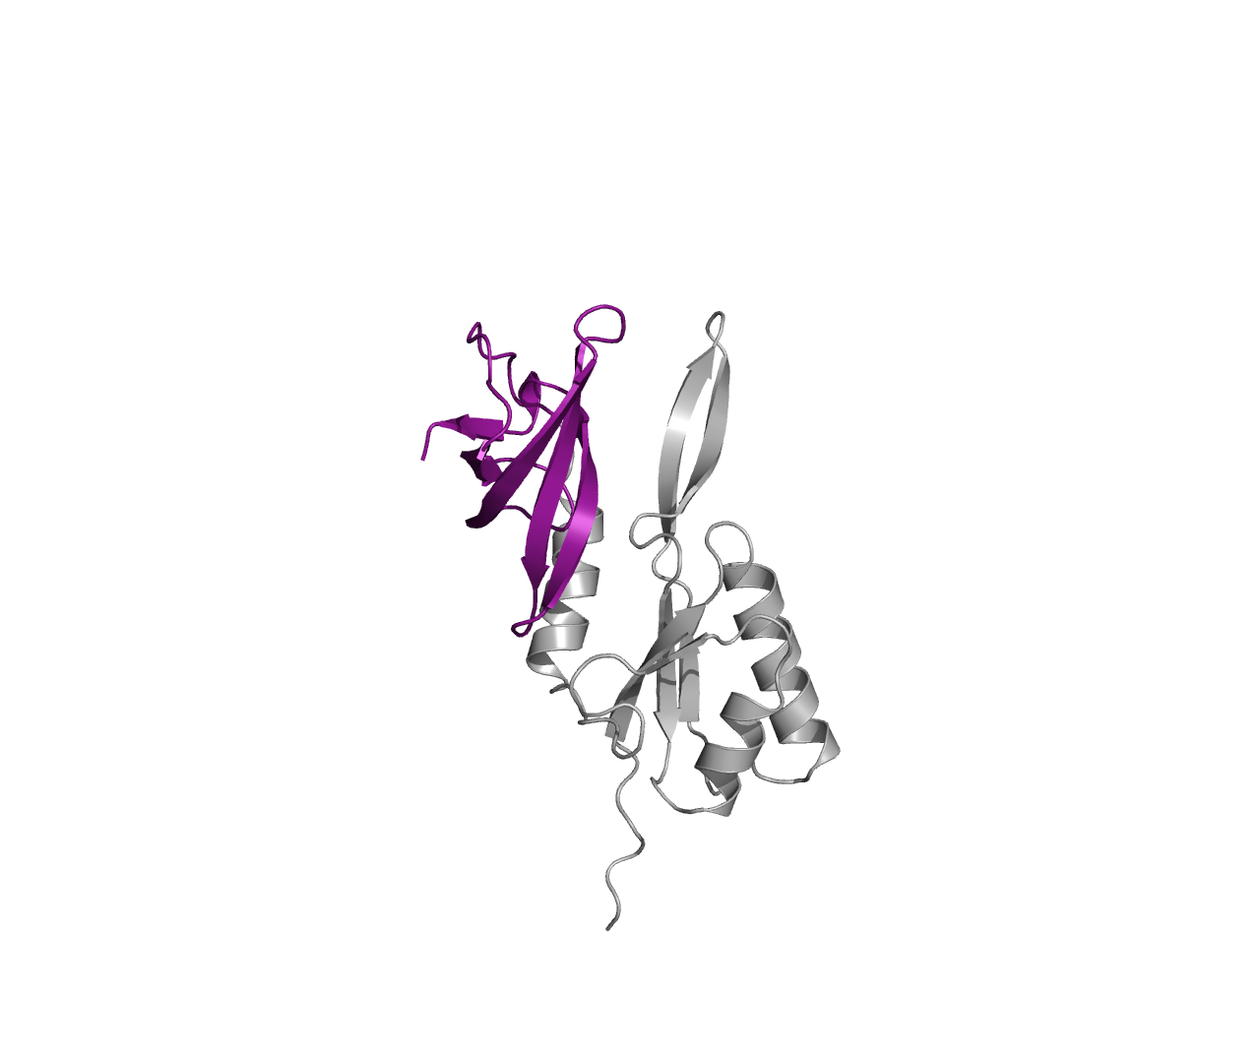
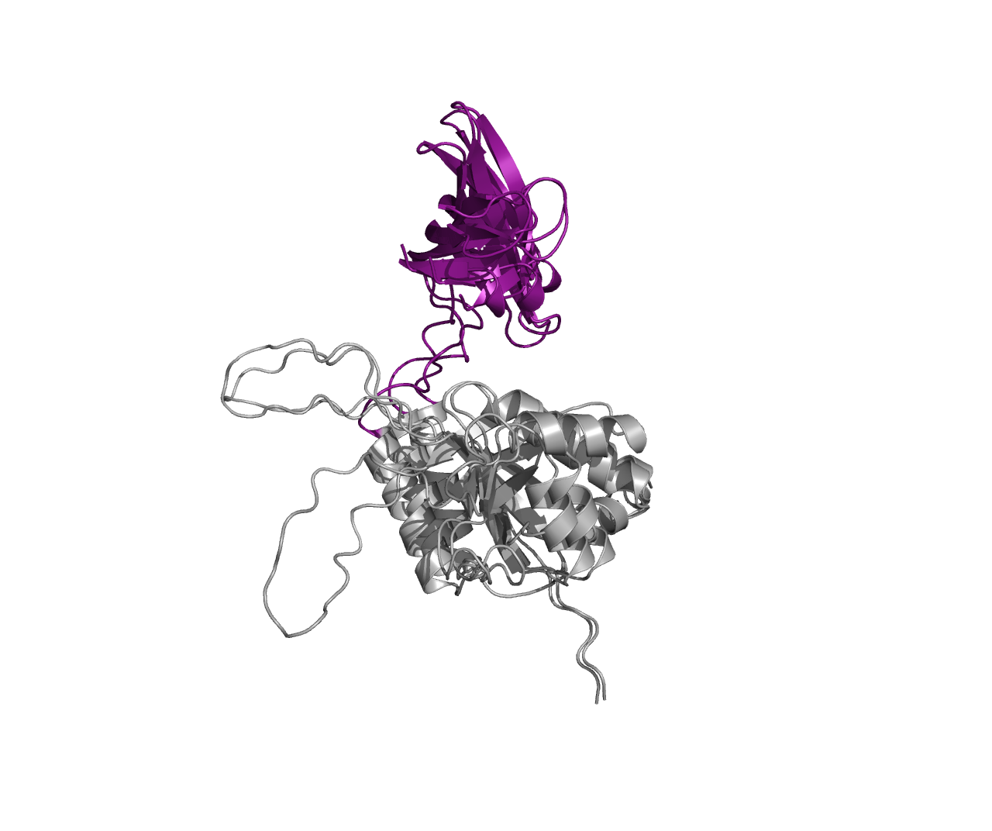
Variant 9
Notes:
nope

Slide 18
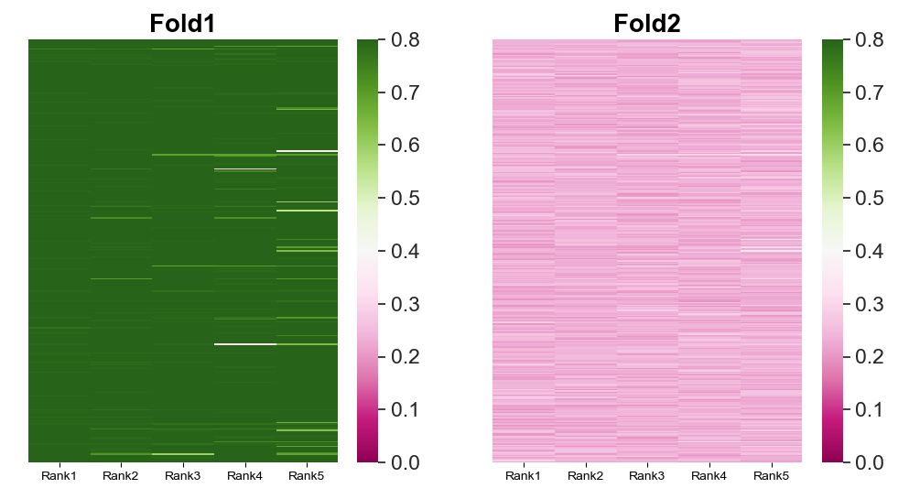
Heatmap of TM-scores, fold-switching region
Notes:
Var9

Slide 19
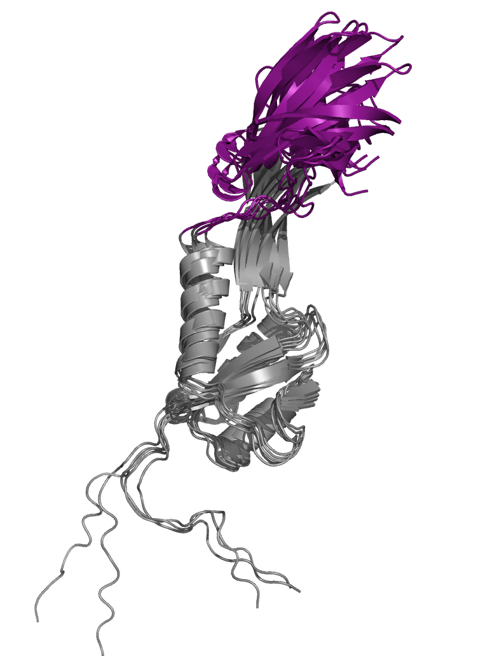
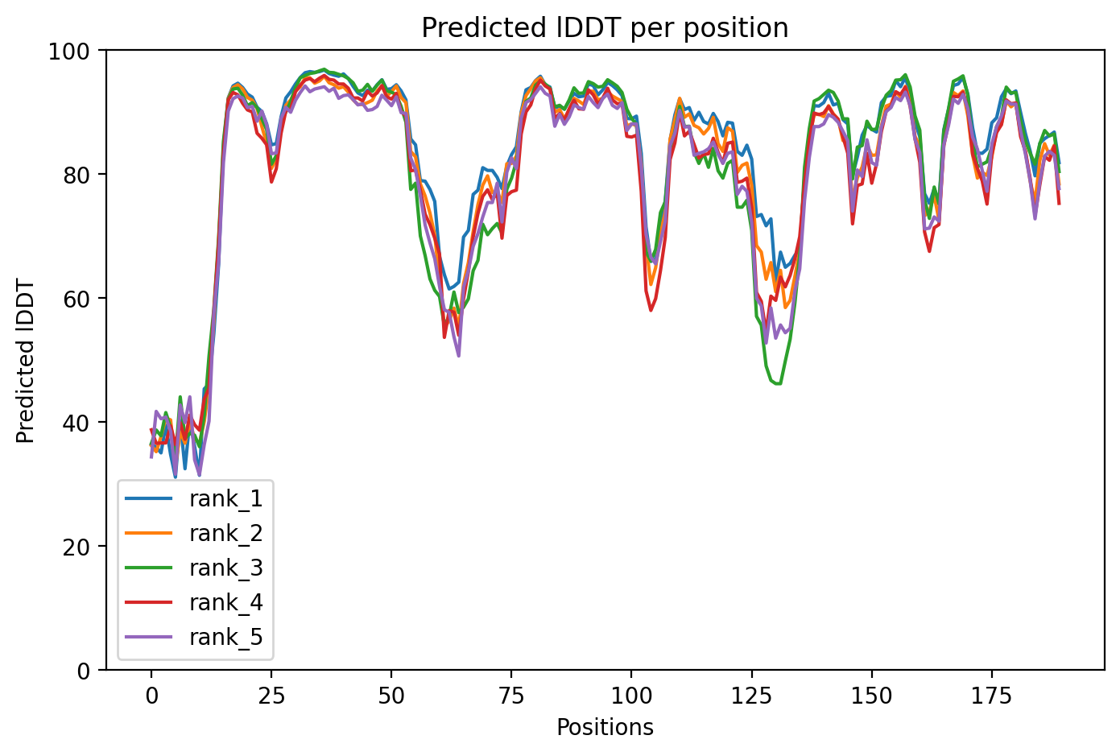
Variant 10
Notes:
some just bad predictions

Slide 20
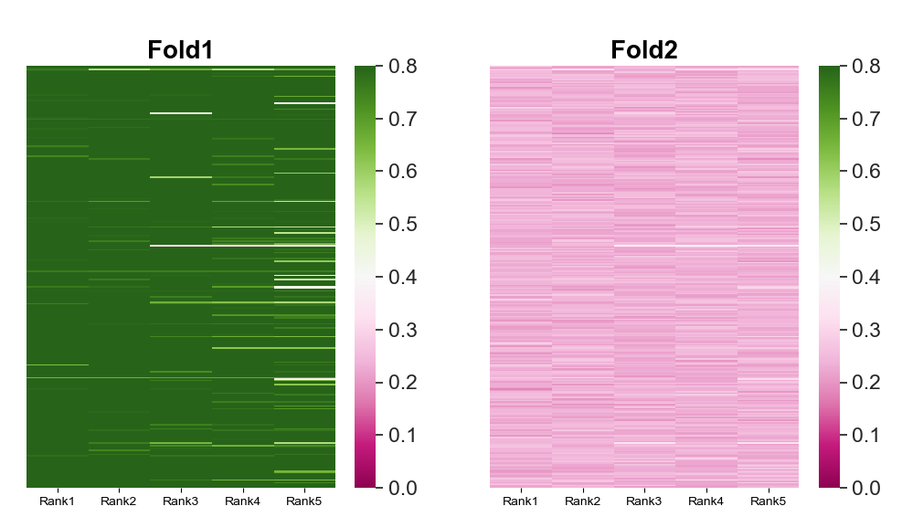
Heatmap of TM-scores, fold-switching region
Notes:
var10

Slide 21
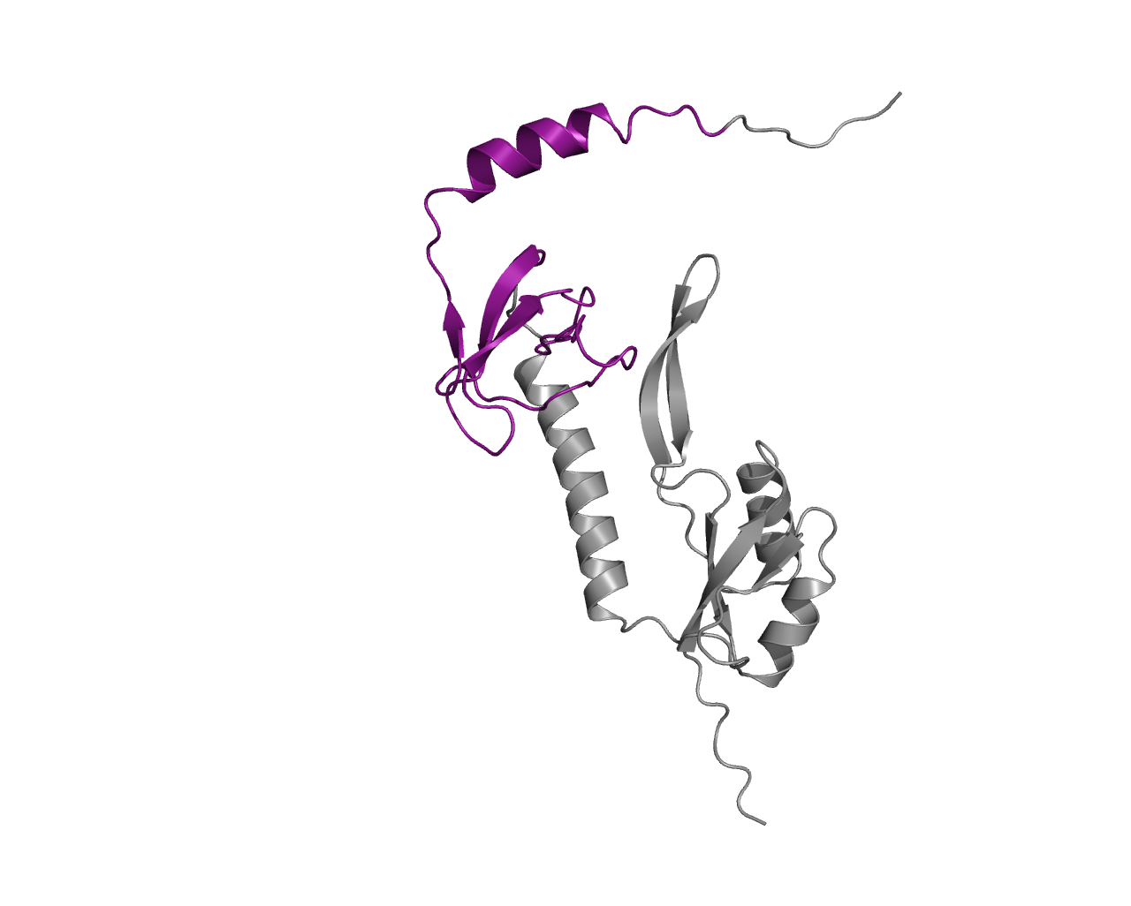
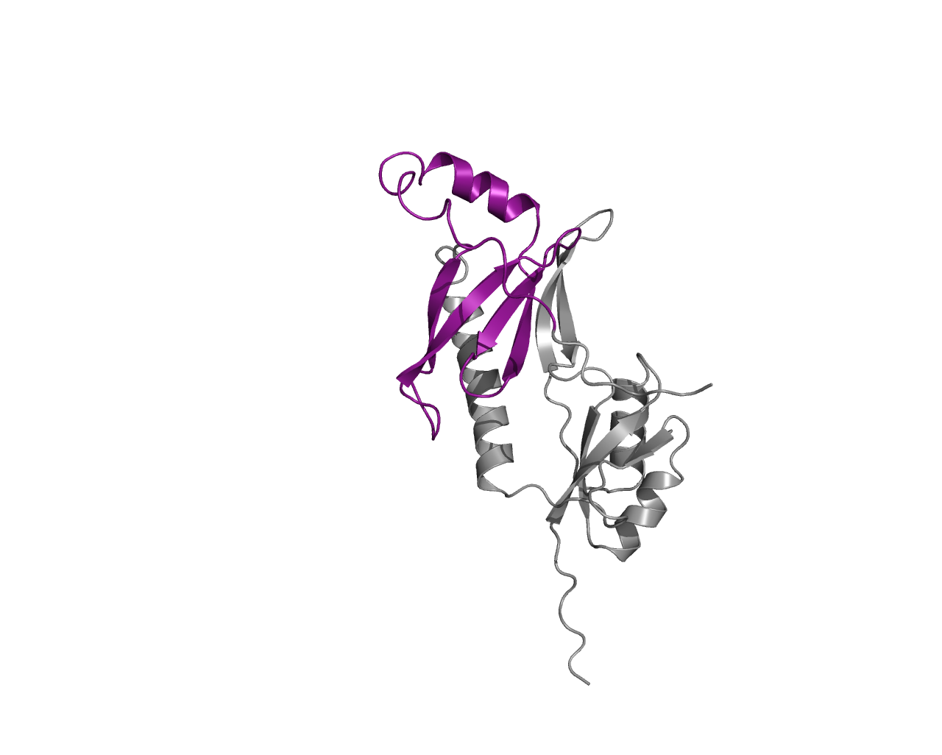
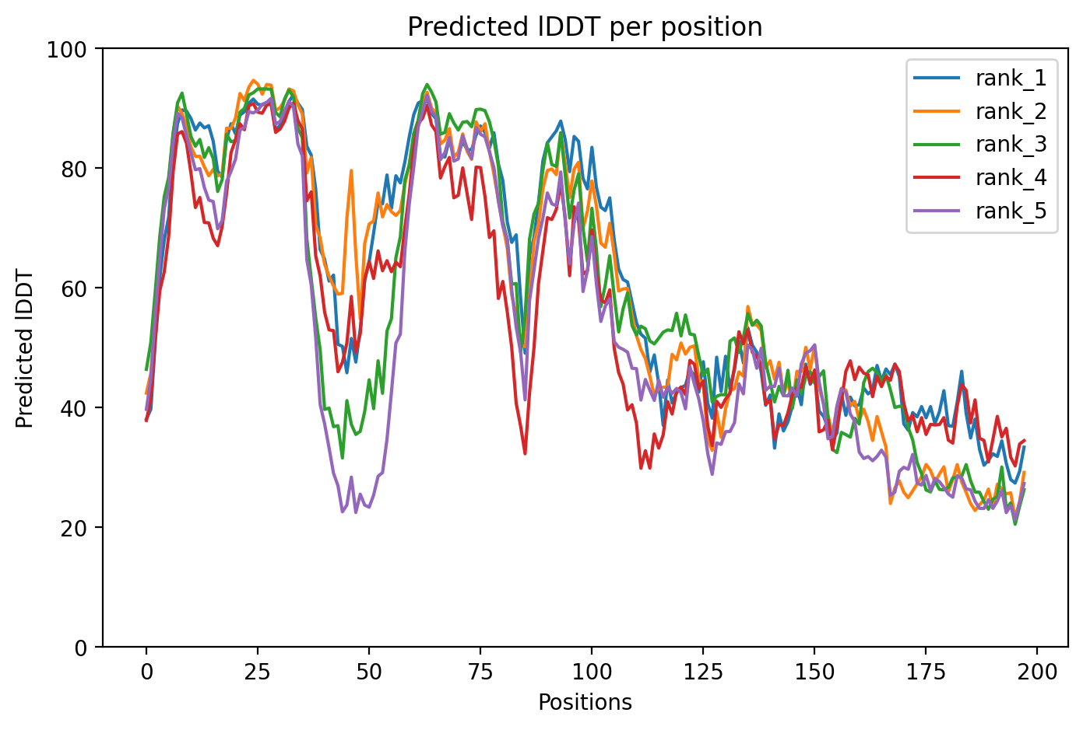
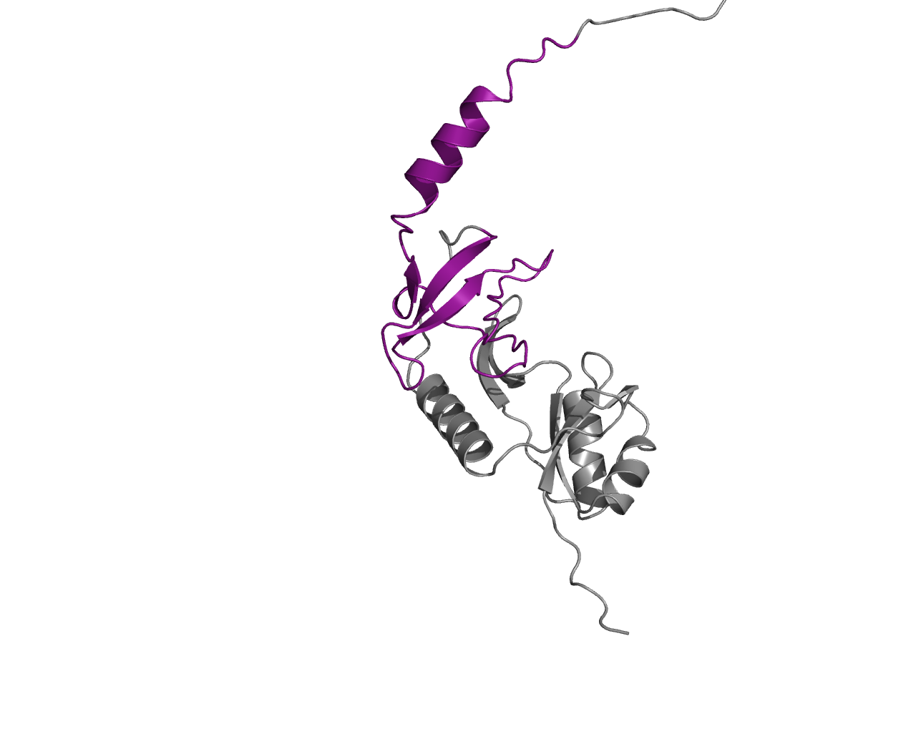
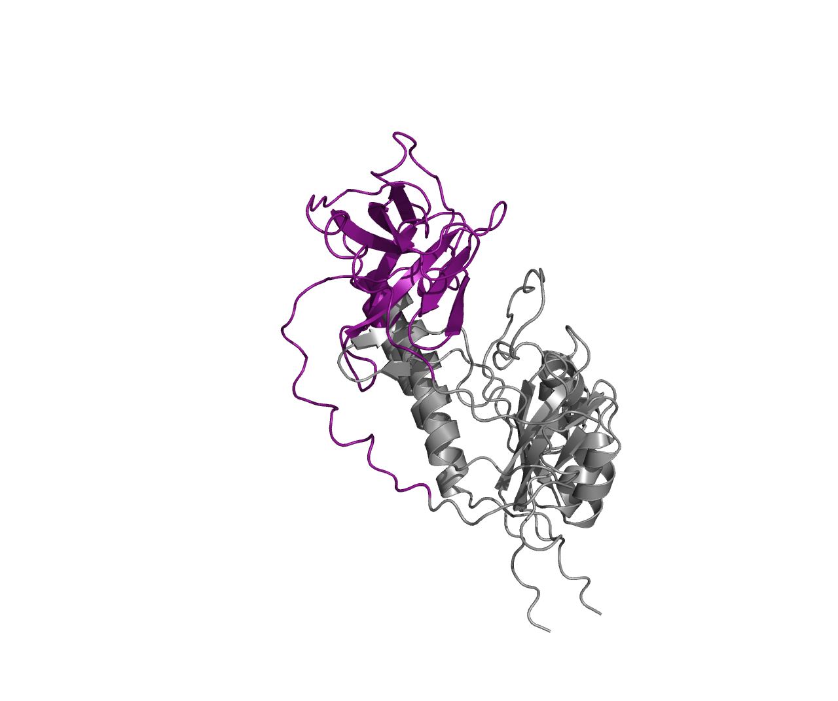
Variant 13
Notes:
Yes, sort of, the last helix

Slide 22
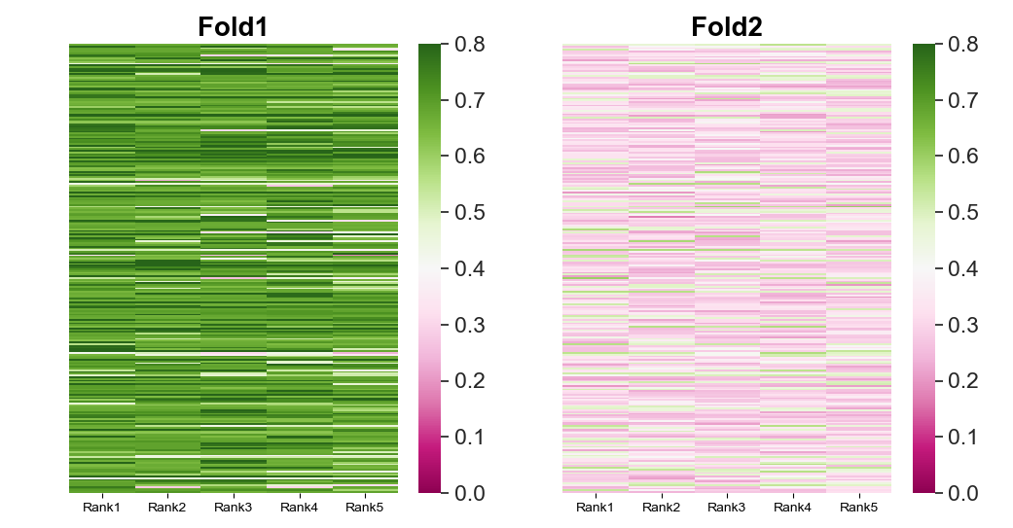
Heatmap of TM-scores, fold-switching region
Notes:
var13

Slide 23
Total # models | acceptable models | Variant
410 | 232 | 1
1095 | 690 | 2
1220 | 126 | 3 (RfaH)
1225 | 186 | 4
1120 | 302 | 5
1345 | 283 | 6
Notes:
Fold-switching variants, acceptable models are defined as having > 70% residues in the predictions with > 70 pLDDT scores

Slide 24
Total # models | acceptable models | Variant
320 | 93 | 7
2820 | 1758 | 8
1675 | 1034 | 9
1485 | 308 | 10
1290 | 46 | 13
1270 | 222 | 14
Notes:
Non-fold-switching variants

